Slide 1
Inheritance (Data Structures and Object Oriented Programming)
Week 04
Course code: cs-216
17 oct, 2022

Slide 2
Inheritance
Inheritance is the process of creating new class called derived class from a base class
Most powerful feature of Object oriented programming
Derived class inherits all the capabilities and characteristics of the base class and having some changes of its owns.

Slide 3
Inheritance
Sub Class: The class that inherits properties from another class is called Subclass or Derived Class or child class.
Super Class: The class whose properties are inherited by a subclass is called Base Class or Superclass or parent class.
Advantage:
1- Reusability
2- reduce Complexity of code

Slide 4
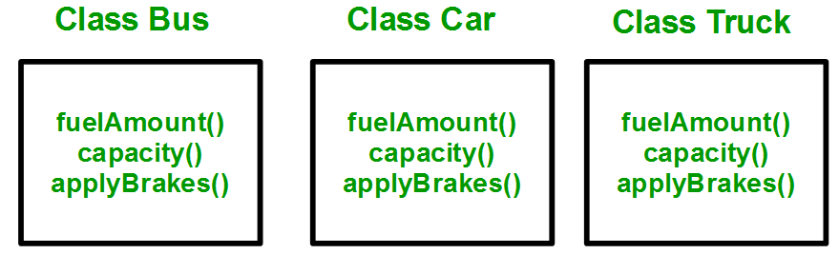
Inheritance (Example)
We have to create three separate classes and The methods fuelAmount(), capacity(), apply Brakes() will be the same for all three classes. Then we have to write all of these functions in each of the three classes as shown below figure:

Slide 5
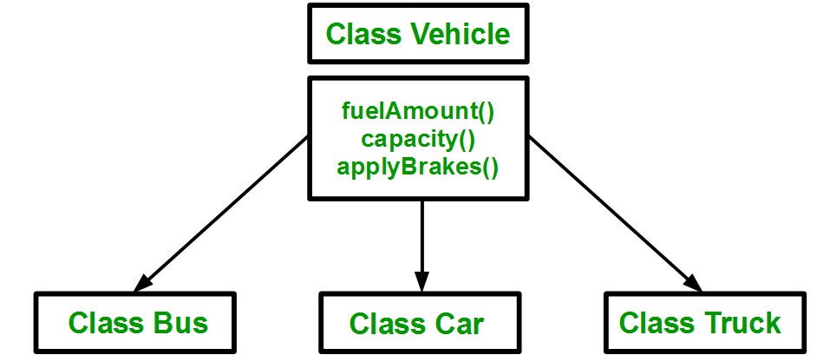
Inheritance (Example)
Using inheritance, we have to write the functions only one time instead of three times as we have inherited the rest of the three classes from the base class (Vehicle).

Slide 6
Derived class (syntax)
Derived class can be define as:
class <derived_class_name> : <access-specifier> <base_class_name>
{
//body
}
Where class : keyword to create a new class derived_class_name : name of the new class, which will inherit the base class access specifier : either of private, public or protected. If neither is specified, PRIVATE is taken as default base-class-name : name of the base class
A derived class doesn’t inherit access to private data members. However, it does inherit a full parent object, which contains any private members which that class declares.

Slide 7
Derived class
Example: 1. class ABC : private XYZ //private derivation { } 2. class ABC : public XYZ //public derivation { } 3. class ABC : protected XYZ //protected derivation { } 4. class ABC: XYZ //private derivation by default { }

Slide 8
Derived class(Example)
class Animal{
eat() ; \\function
sleep() ;
class Dog : public Animal {
// bark() function
};

Slide 9
Inheritance(example)
#include <iostream>
#include <string>
using namespace std;
// Base class
class Vehicle {
public:
string brand = "Ford";
void horn) {
cout << "Tuut, tuut! \n" ;
}
};
// Derived class
class Car: public Vehicle {
public:
string model = "Mustang";
};
// main function
int main()
{
Car myCar;
myCar.horn();
cout << myCar.brand + " " + myCar.model;
return 0;
}

Slide 10
Protected Members
Access modifier protected is especially relavant when it comes to inheritance
Like private members private are inaccessible outside of class. However they are accessible to derived classes.

Slide 11
Inheritance and Accessibility
Access Specifier | Accessible from own class | Accessible from derived class | Accessible from object outside class
public | yes | yes | yes
protected | yes | yes | no
private | yes | no | no

Slide 12
Access Specifier’s
Public, protected, and private inheritance have the following features:
Public inheritance makes public members of the base class public in derived class, and the protected members of the base class remain protected in derived class.
Protected Inheritance makes the public and protected members of the base class protected in the derived class.
Private inheritance makes the public and protected members of the base class private in the derived class.
Note: private members of the base class are inaccessible to the derived class.

Slide 13
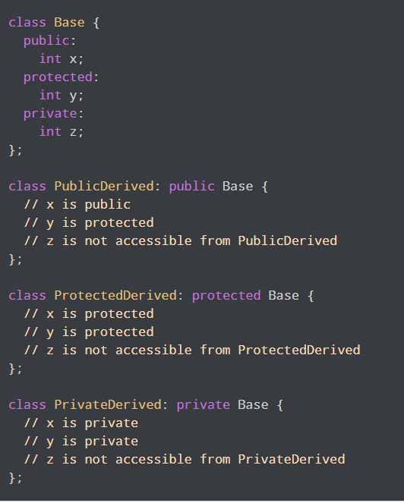

Slide 14
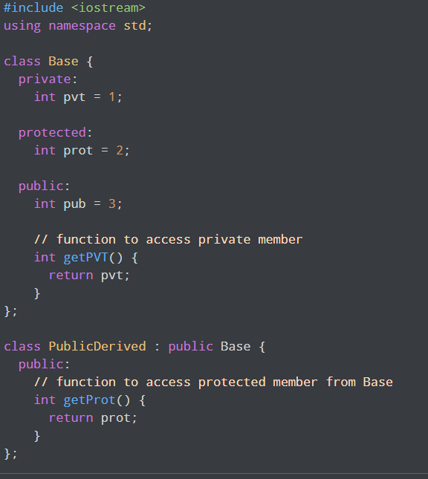
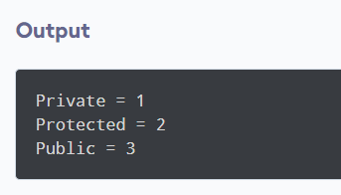
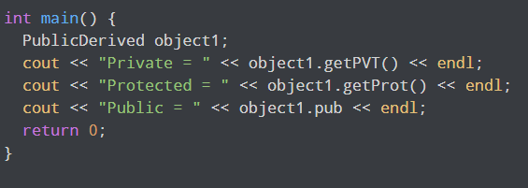

Slide 15
Examples
Consider examples from book.

